Slide 1
(C++) Programmers self-help group
Daniel Evers
dermojo@gmail.com
https://github.com/dermojo/

Slide 2
I write crappy software

Slide 3
I introduce bugs. (Testing is for QA/CI/CD/compilers)

Slide 4
I skip unit tests.

Slide 5
I write C-style code. (Macros, void*, manual clean-up …)

Slide 6
I use C functions without a type-safe wrapper. (memset, memcpy, …)

Slide 7
template<class T> void typesafe_memset(T& obj, int val) { static_assert(std::is_trivially_copyable<T>::value, "this type isn't memset'able!"); memset(&obj, val, sizeof(T)); }

Slide 8
I prematurely optimize code.

Slide 9
I copy & paste code. (Great backup if you don‘t have version control…)

Slide 10
I write clever code. (that even I won‘t understand next week…)

Slide 11
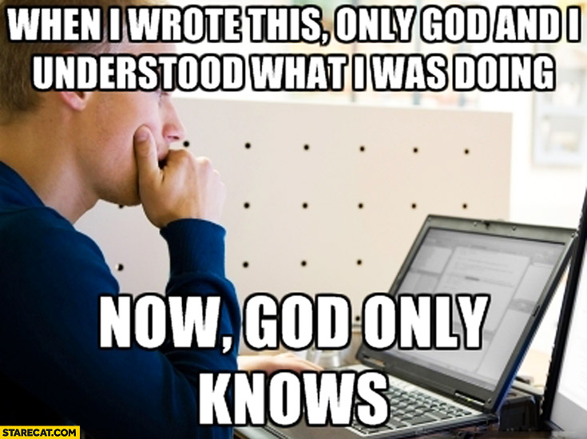

Slide 12
I aggressively clean up code. (including “obsolete” legacy functionality…)

Slide 13
Allow me to accept the code I cannot change, the courage to change the code I can, and the tools to know the difference.

